Slide 1








AI-EXPLORERS
BY TEAM 10

Slide 2




THE COSMIC CODE: TEACHING RESPONSIBLE AI TO KIDS
Our mission is to make the principles of Responsible AI accessible and engaging for young children by using interactive, space-themed storytelling and activities

Slide 3



OUR TEAM
SARA BUCHEERI
MARYAM AYSHA
We're a team of passionate innovators combining creativity, technology, and ethics to inspire the next generation of responsible AI users and developers.
SABIKA AMJAD

Slide 4



WEBSITE OVERVIEW
STRUCTURE
FEATURES
PURPOSE

Slide 5
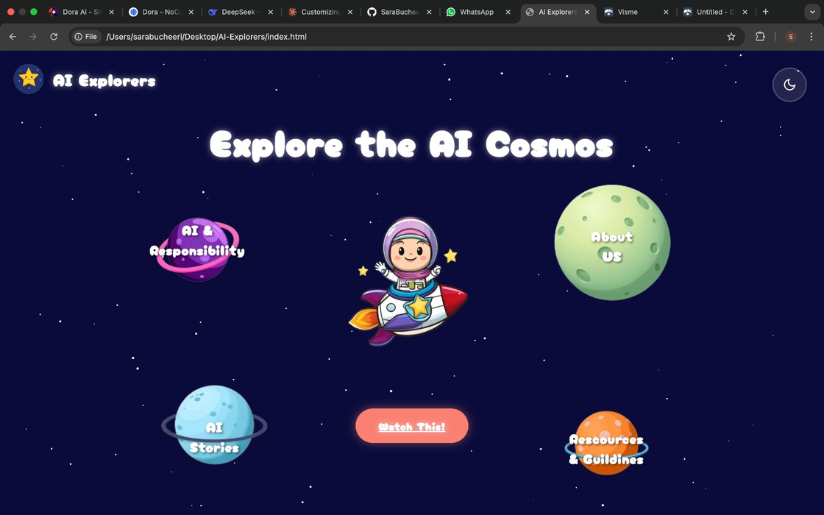




STRUCTURE
Home/Landing Page: Introduction to Najma and the website.
Principles of Responsible AI: Interactive buttons for AI principles.
Case Studies: Short, kid-friendly examples of Responsible AI in action
.
Resources: Links for parents and teachers.
About Us: Team introduction.
LANDING PAGE

Slide 6
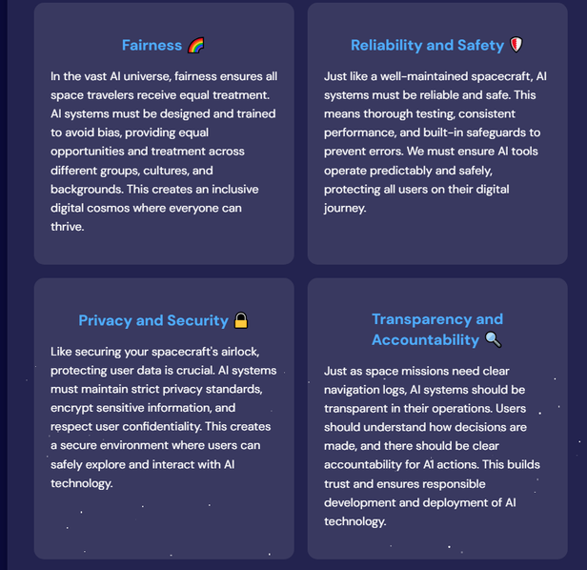
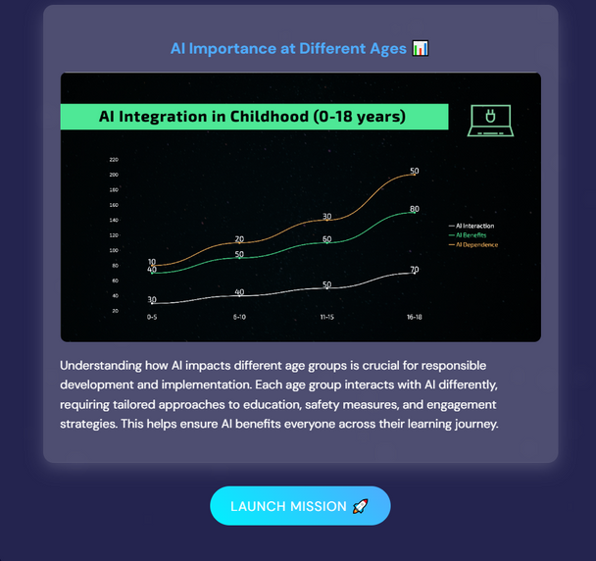
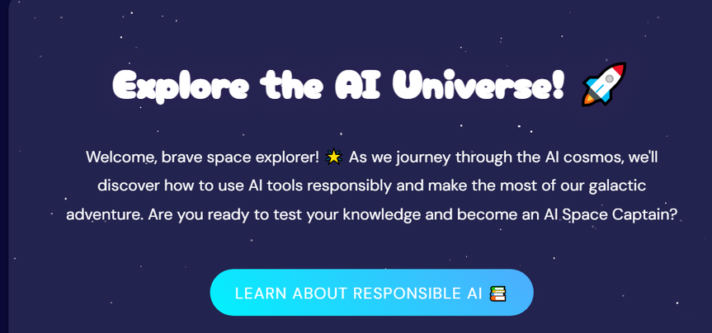

STRUCTURE
AI AND RESPONSIBILITY

Slide 7
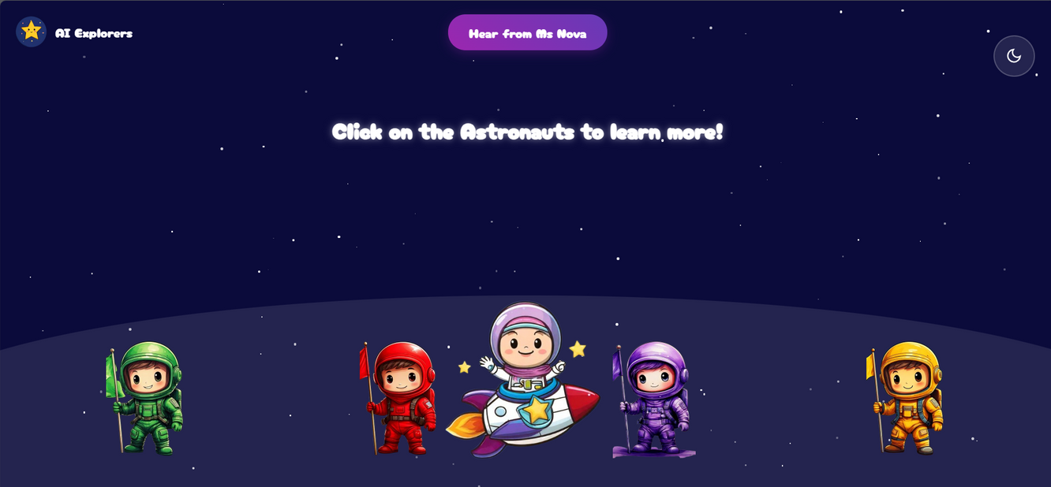
STRUCTURE
CASE STUDIES

Slide 8
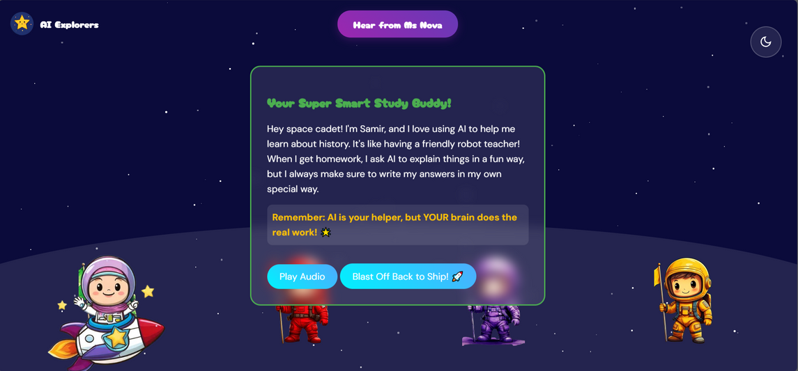
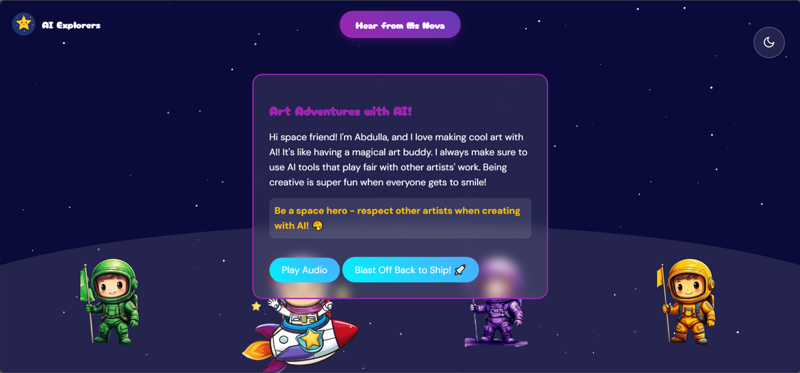
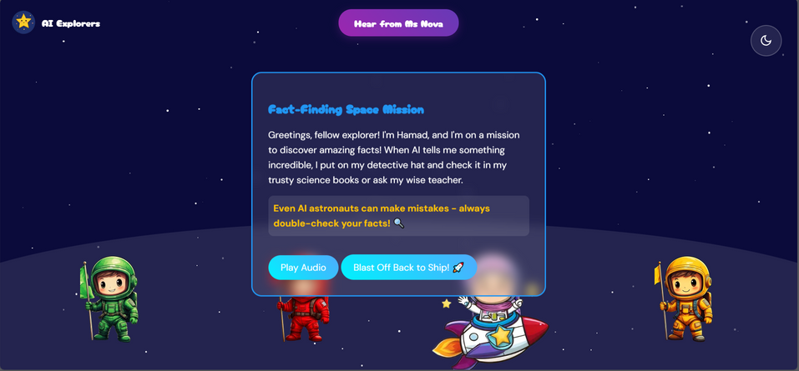
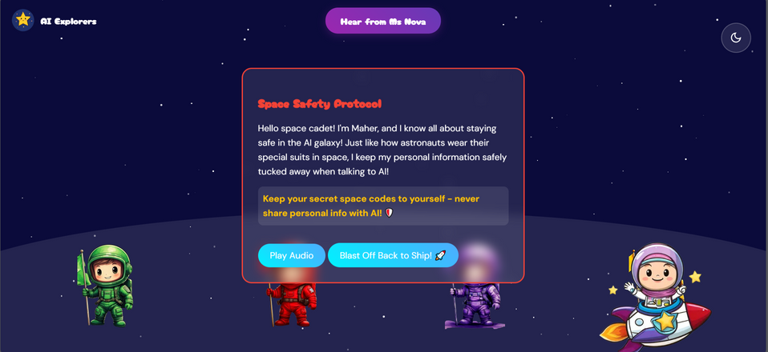
STRUCTURE
CASE STUDIES

Slide 9
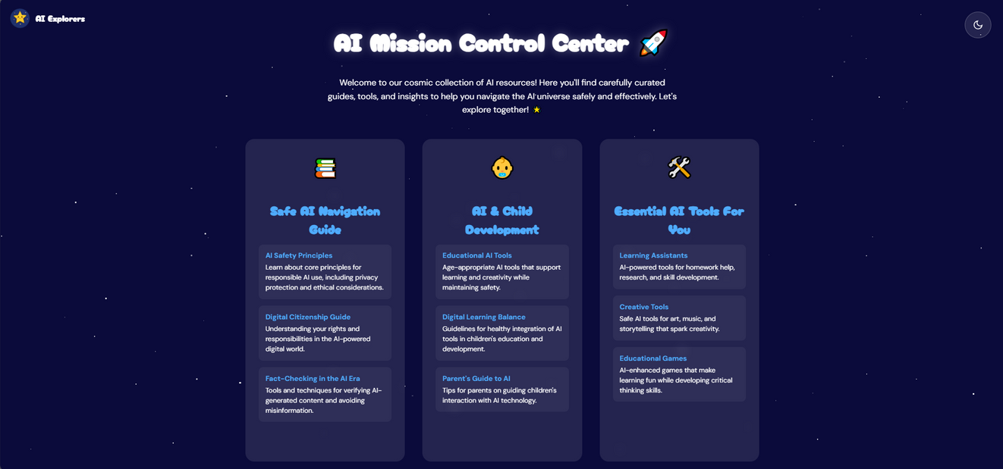
STRUCTURE
RESOURCES AND GUIDELINES

Slide 10
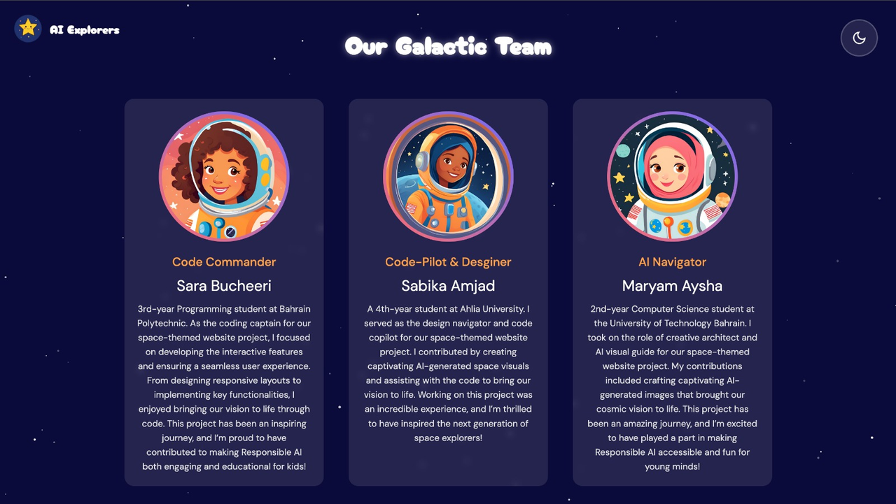
STRUCTURE
ABOUT US

Slide 11
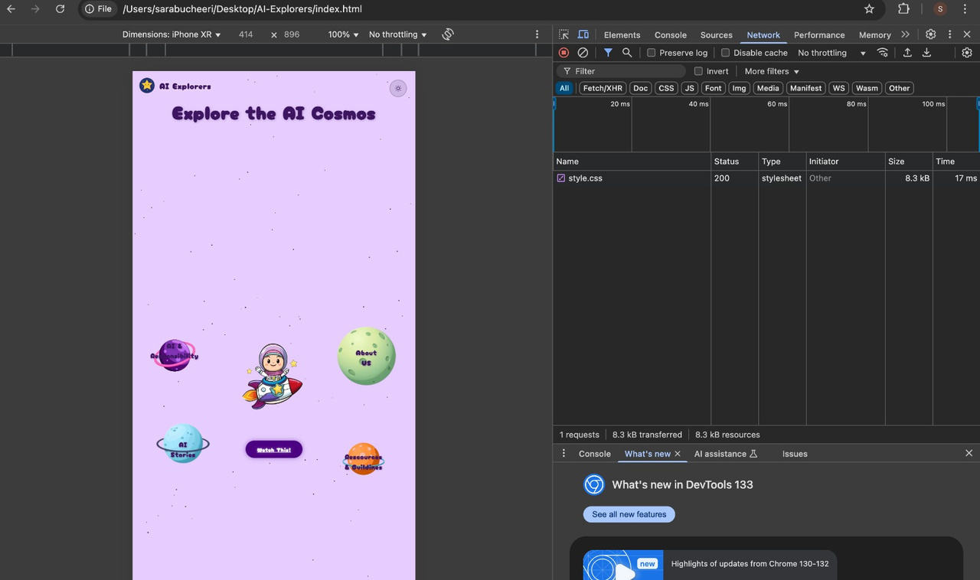
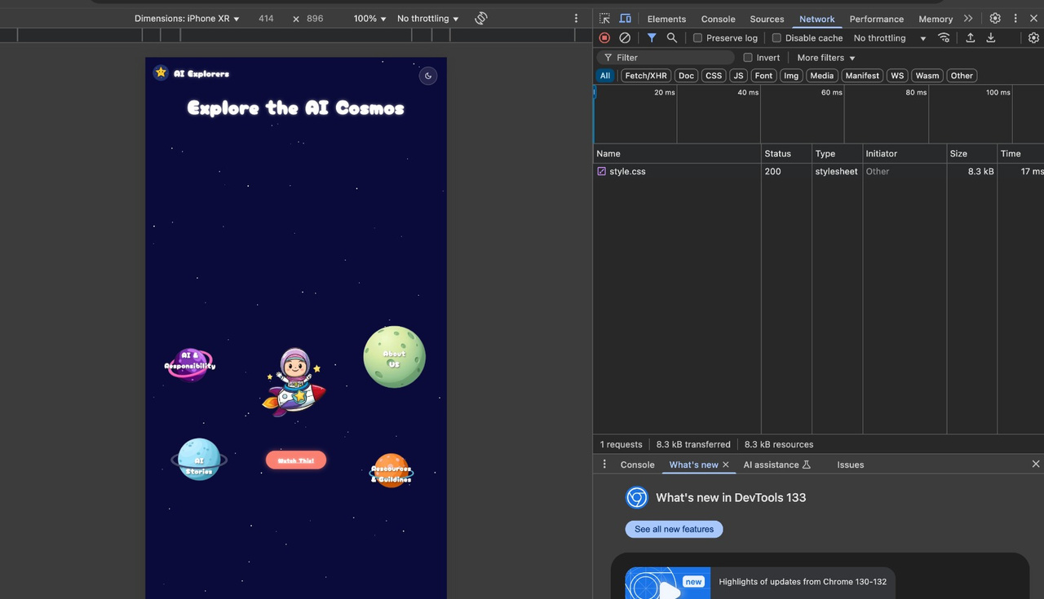
FEATURES
Animations
Light/Dark mode
Responsiveness
Interactive infographics
Gamified learning
light mode dark mode

Slide 12
FEATURES
Animations

Slide 13

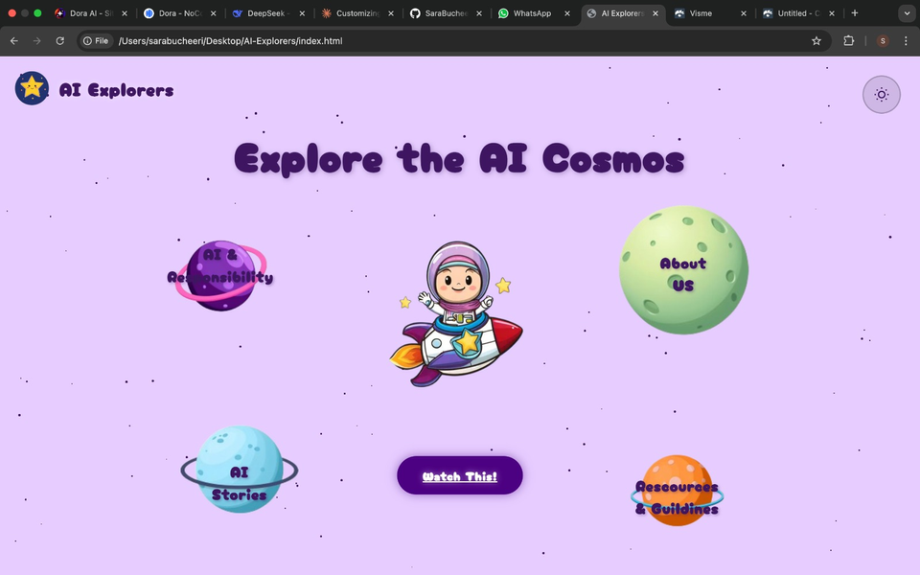
FEATURES
Light/Dark mode

Slide 14
FEATURES
Mobile Compatibility

Slide 15
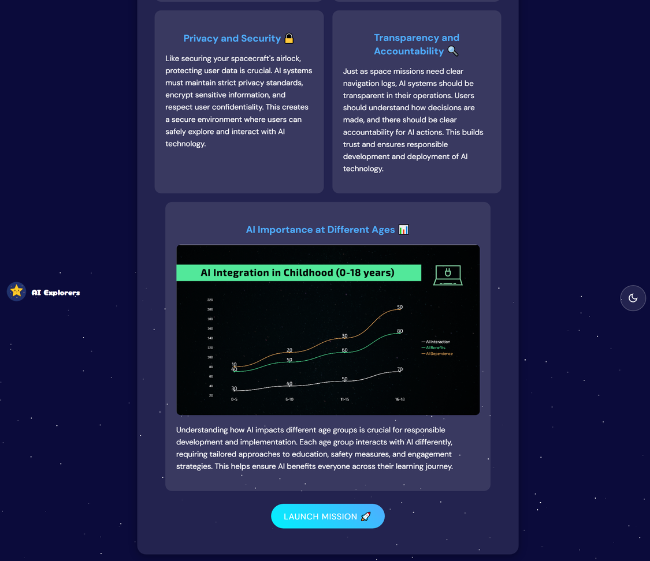
FEATURES
Interactive infographic

Slide 16
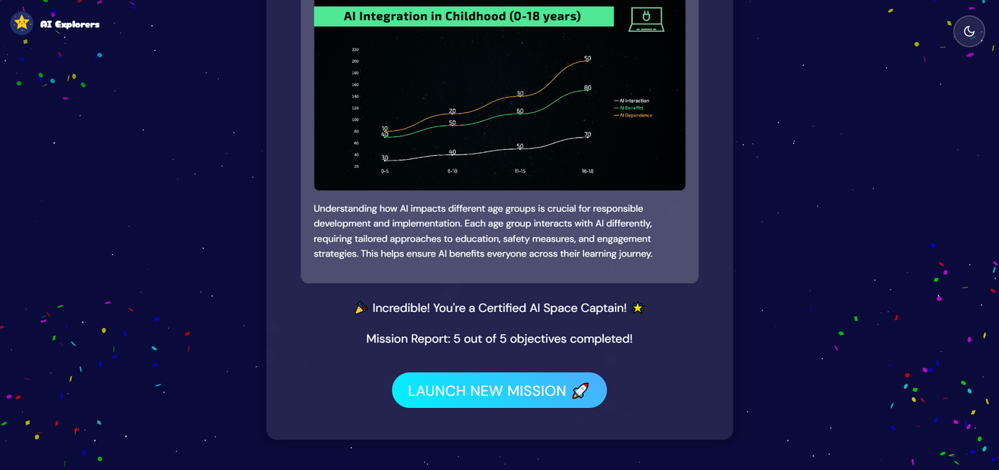
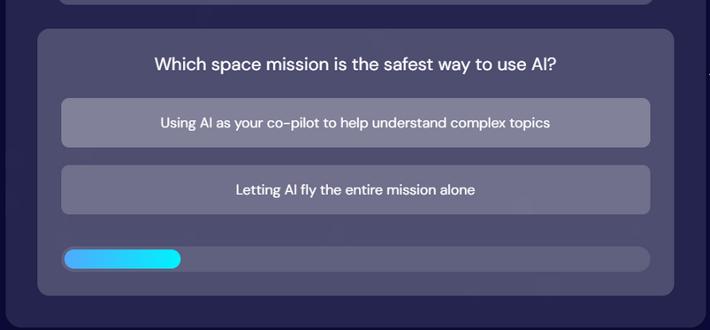
FEATURES
Gamified learning

Slide 17

PURPOSE
Our goal is to educate young minds about Responsible AI principles, making it engaging and accessible through an interactive, space-themed experience.

Slide 18

MEDIA DEMONSTRATION

Slide 19
DEVELOPMENT PROCESS
TOOLS USED:
1. ADOBE FIREFLY 2. CANVA 3. CLAUDE
4. DEEPSEEK 5.INVIDEO AI 6. COPILOT
7. CHATGPT 8. VOICEOVERKIDS AI 9. DORA AI
10. VISME 11. D-ID 12.PICSART

Slide 20
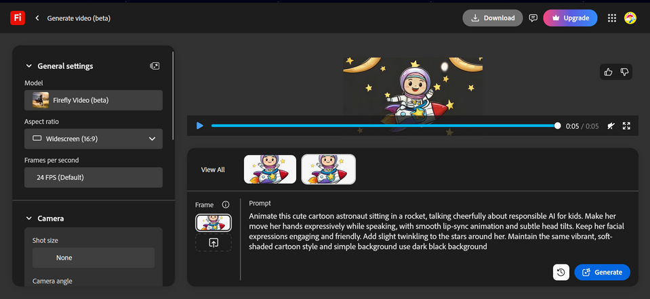
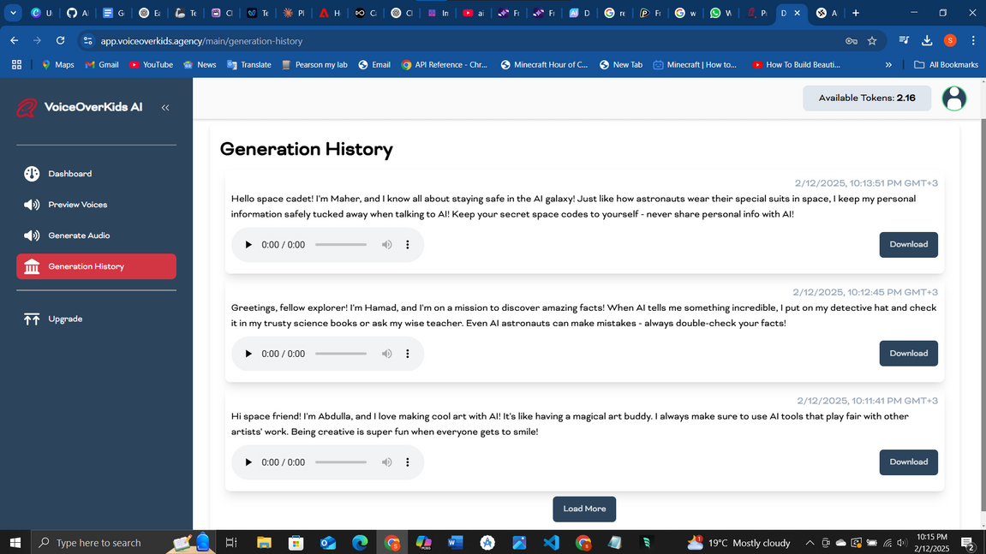
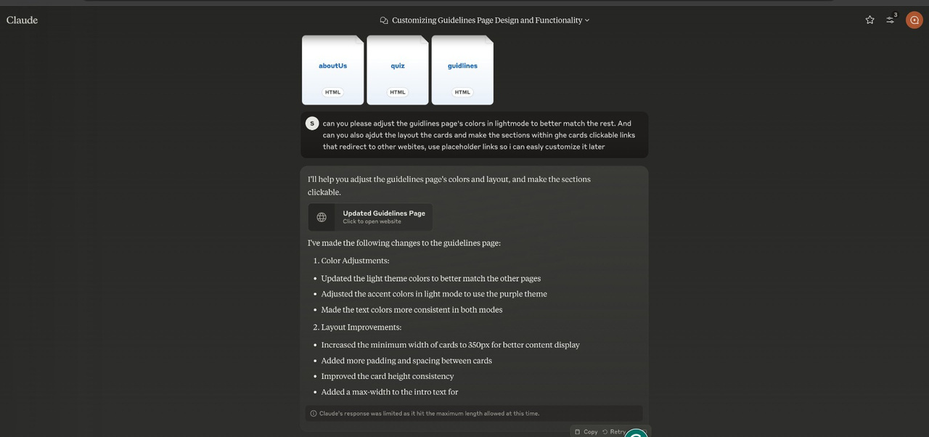
DEVELOPMENT PROCESS
PROMPTS :

Slide 21
USABILITY
DEMONSTRATE WEBSITE USER EXPERIENCE

Slide 22
IMPACT OF THE COSMIC CODE
fff
BENIFITS
EDUCATIONAL
ETHICAL AI AWARENESS
INCLUSIVITY
- TEACHES CHILDREN ABOUT RESPONSIBLE AI CONCEPTS LIKE FAIRNESS, TRANSPARENCY, AND ACCOUNTABILITY.
- Helps them understand how AI impacts their lives and the world around them.
- Encourages critical thinking and ethical decision-making when using technology.
- Uses interactive and relatable content to make learning engaging and accessible.
- Inspires children to become informed, responsible digital citizens.
- Fosters a generation that is both tech-savvy and ethically aware.

Slide 23

THANK
YOU

Slide 24
Q&A
SESSION

